Slide 1
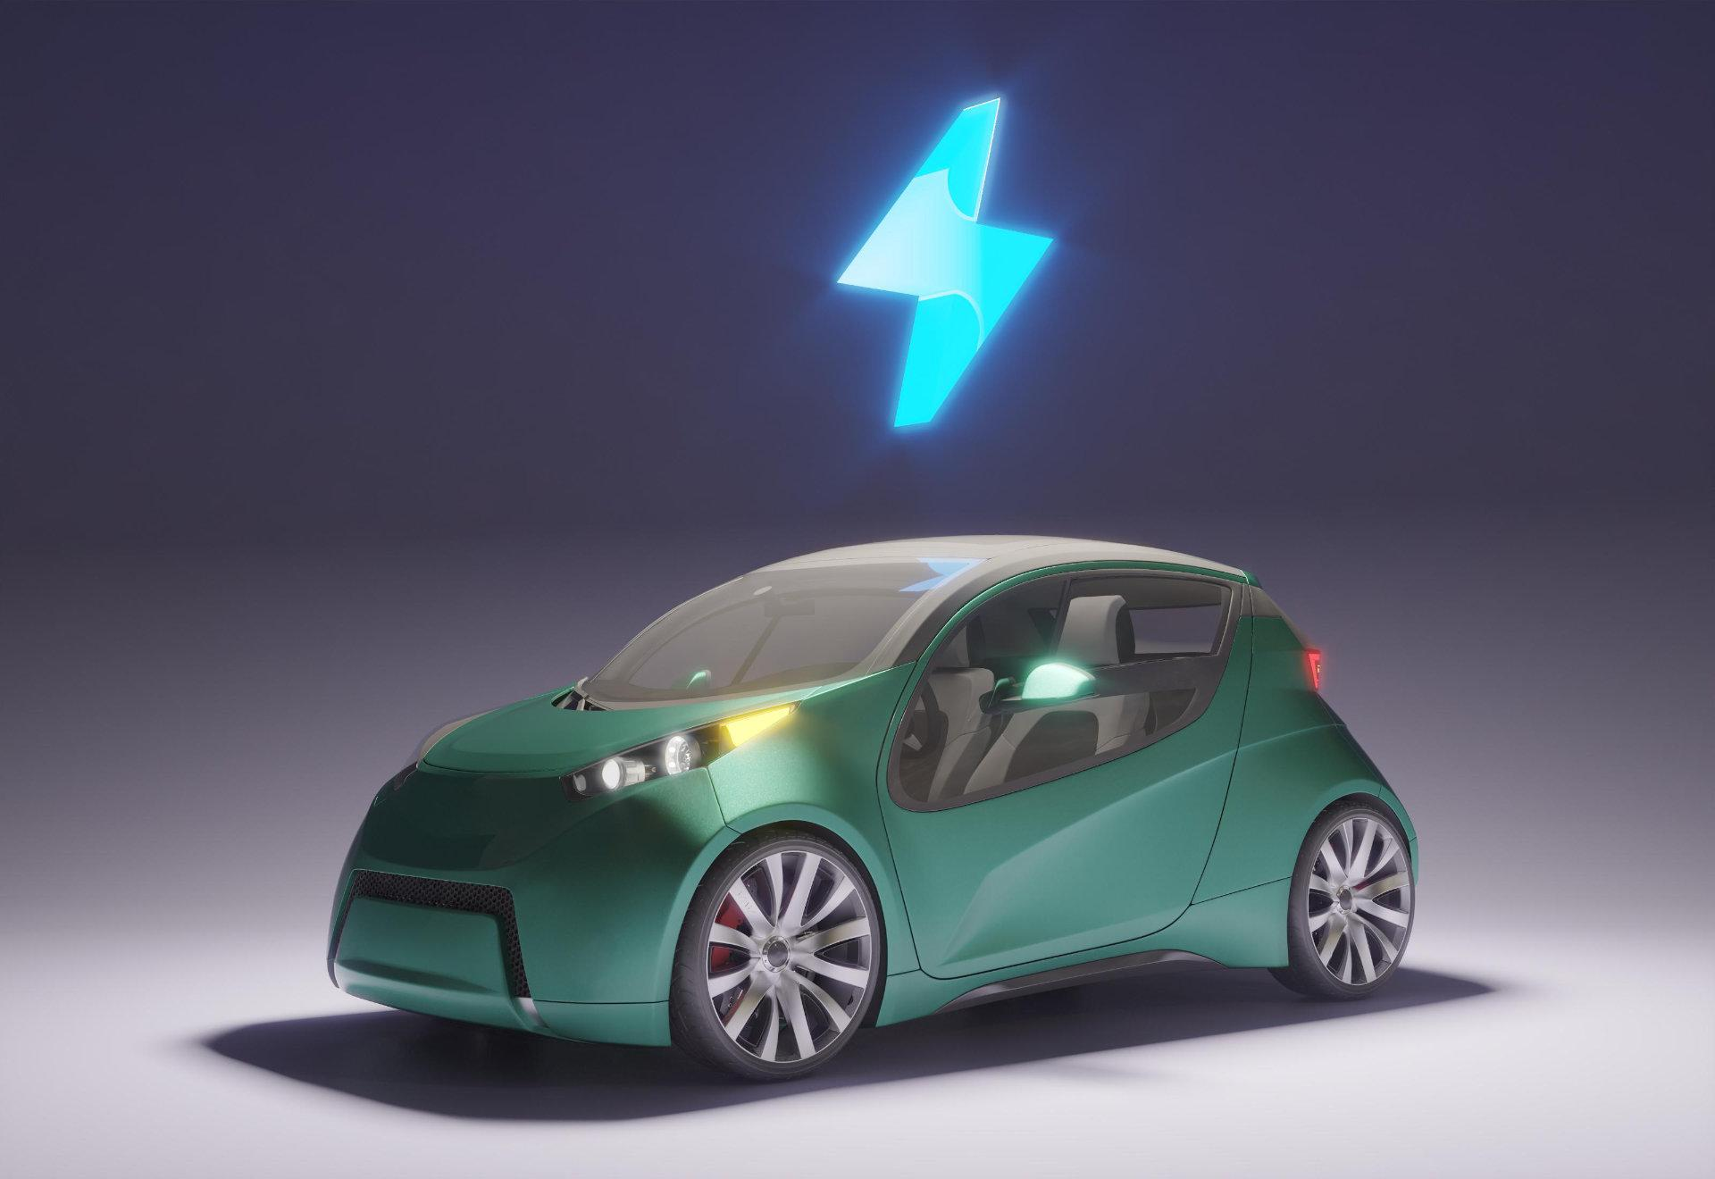
MERCEDES cAR DEALERSHIP
WE ARE HERE TO SERVE !!!

Slide 2

PRESENTER
YEBOAH PRINCE SEFA
+ A student of Ashesi
+ Computer Science Major

Slide 3
TABLE OF CONTENTS
01
03
02
04
BACKGROUND
IMPLEMENTATION
Purpose, Services, Functions
Libraries, Frameworks, API’s
ARCHITECTURE & DESIGN
DEMO
3-tier Architecture
A brief walkthrough of Mercedes Car Dealership

Slide 4

01
MISSION OF MERCEDES
The entire mission of the system is to provide people, specifically, high income earners in Ghana an opportunity to purchase Mercedes products online, here in Ghana

Slide 5
VISION OF MERCEDES
Our vision is to process internet orders and ship the various orders or appointments through delivery or via mails

Slide 6
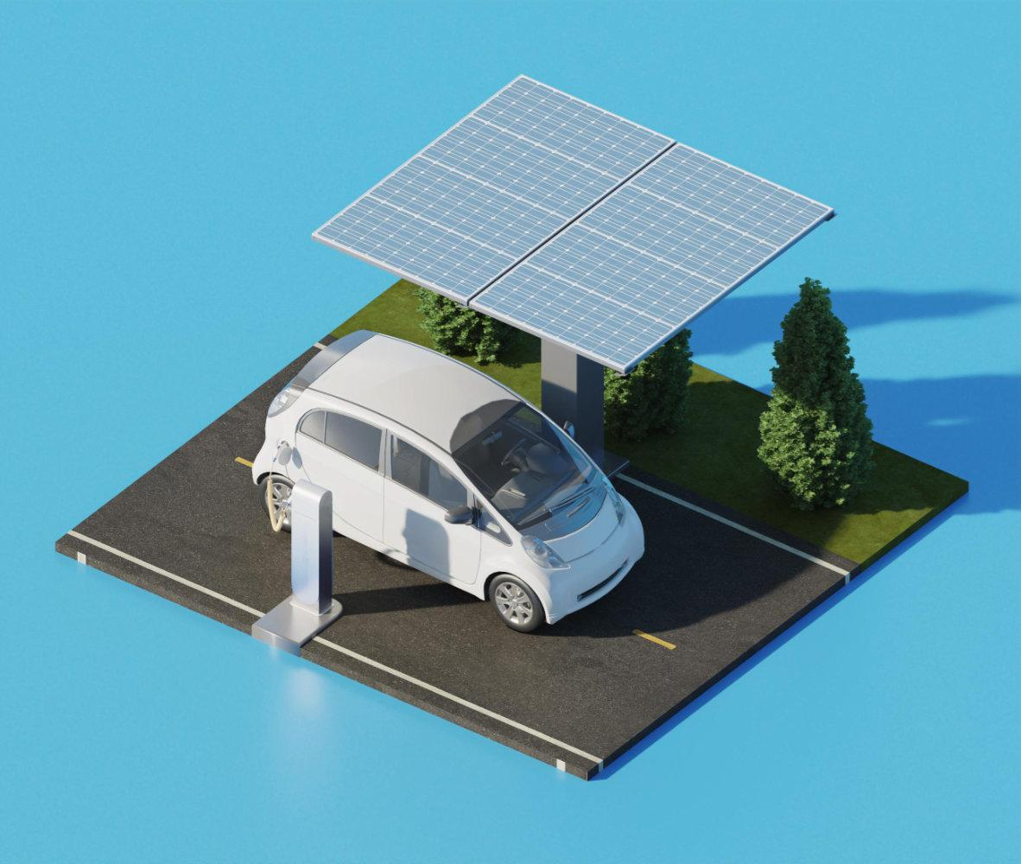
OUR TARGET MARKET
Our target market is YOU! People who do not want to walk all the way to Mercedes to inquire or to purchase a vehicle, yet want it delivered to them in the comfort of their homes.

Slide 7
FUNCTIONALITIES
GOAL 3
Cart and Checkout functionality
GOAL 1
A registratin system
GOAL 2
Admin panel for Mercedes administrators

Slide 8
ARCHITECTURE AND DESIGN
01
02
03
+ PRESENTATION
+ APPLICATION
+ DATABASE
HTML
CSS
PHP
JAVASCRIPT
MySQL

Slide 9

IMPLEMENTATION
+ Bootstrap Framework
+ Font Awesome Library

Slide 10
— ROY BARTEL -
“Most people think ‘selling’ is the same as ‘talking’. But the most successful people know that listening is the most important part of their job. ”

Slide 11
WEBSITE DEMO
Let’s go!!!

Slide 12
THANK YOU
Asante!!!

